Slide 1
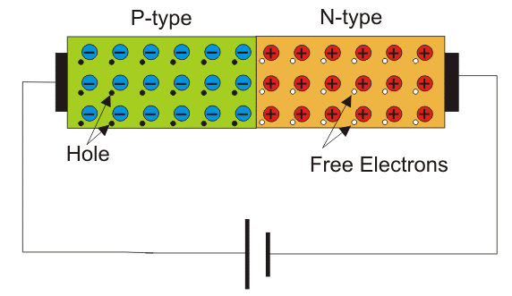
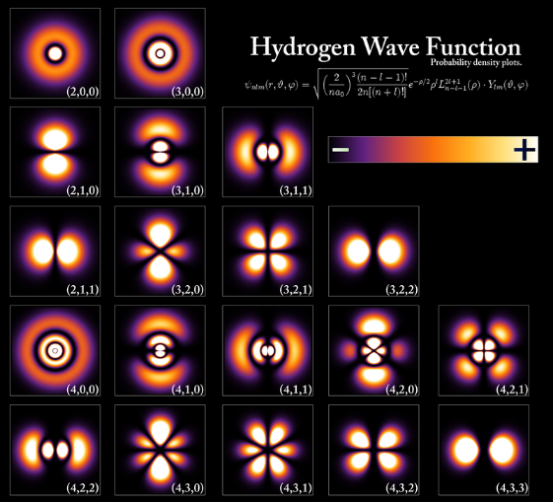

CO2015 Diode & Its Applications

Slide 2
Diode and Its Applications
Introduction to semiconductor
Diode
Applications

Slide 3
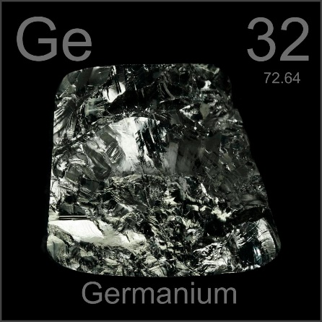
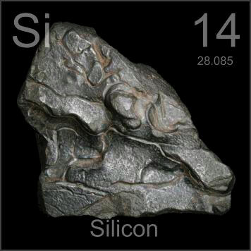
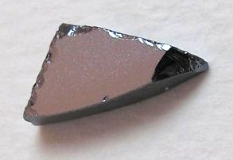
Semiconductor
Semiconductors are a special class of elements having a conductivity between that of a good conductor and that of an insulator.
Two classes: single-crystal and compound
The three semiconductors used most frequently in the construction of electronic devices are Ge, Si, and GaAs.

Slide 4

Germanium (Ge)
The discovery of the diode in 1939 and the transistor in 1947 germanium was used almost exclusively
Advantages
Easy to find
Fairly large quantities
Easy to refine to obtain very high levels of purity
Disadvantage
Sensitivity to changes in temperature

Slide 5
Silicon (Si)
1954 the first silicon transistor was introduced
Advantages
Less temperature sensitive
The most abundant materials on earth
High levels of purity
Disadvantage
Sensitive to issues of speed.

Slide 6
Gallium Arsenide (GaAs)
The first GaAs transistor in the early 1970s.
New transistor had speeds of operation up to five times that of Si.
GaAs was more difficult to manufacture at high levels of purity, was more expensive.
Today, it is often used as the base material for new high-speed, very large scale integrated (VLSI) circuit designs.

Slide 7
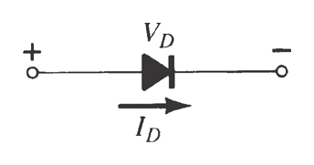
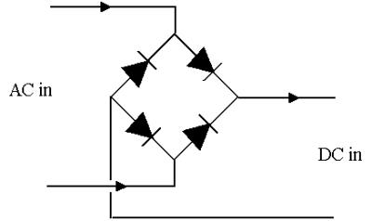
Diode
The diode is the simples and most fundamental non-linear circuit element
Like a resistor, it has two terminals
Unlike a resistor, it has a non-linear current-voltage characteristics.
Its use in rectifiers is
the most common application

Slide 8
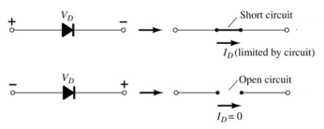
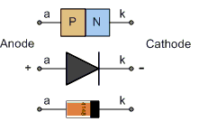
Diode
Diode is an electric device which allows current to flow only in one direction.
The voltage applied to the semi conductor diode is referred to as bias voltage
There are two types of bias voltage
Forward biased
Reversed biased

Slide 9
PN Junction and Diode

Slide 10
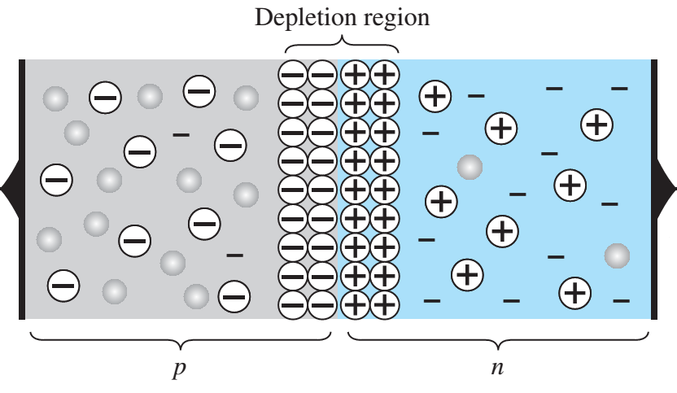
PN Junction and Diode
One end of a silicon or germanium crystal can be doped as a p-type material and the other end as an n-type material.
At the p-n junction, the excess conduction-band electrons on the n-type side are attracted to the valence-band holes on the p-type side.
Notes:
The electrons in the n-type material migrate across the junction to the p-type material (electron flow).
Electron migration results in a negative charge on the p-type side of the junction and a positive charge on the n-type side of the junction.
The result is the formation of a depletion region around the junction

Slide 11
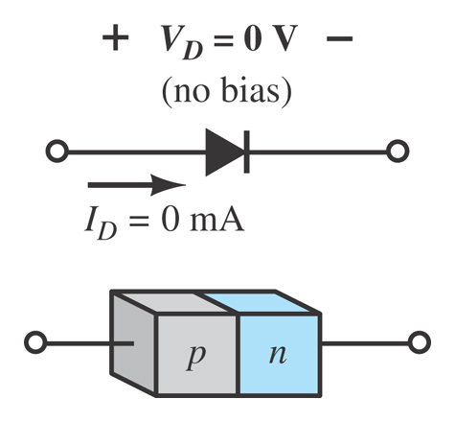
Diode – No Bias
No external voltage is applied: V_{D} = 0 V
There is no diode current: I_{D} = 0 A
Only a modest depletion region exists

Slide 12
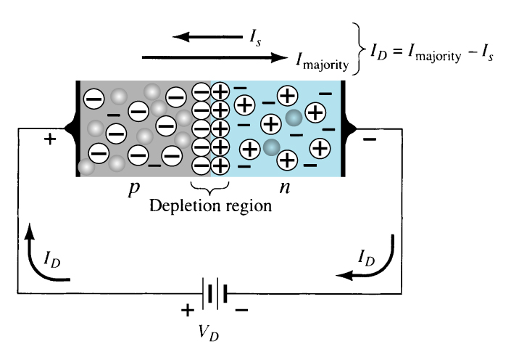
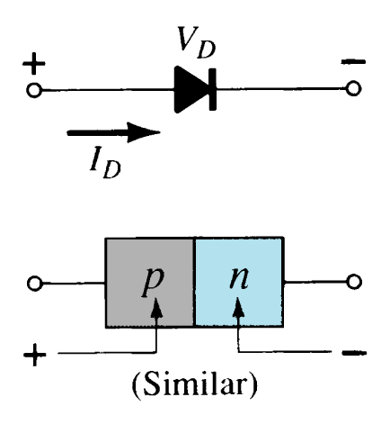
Diode – Forward Bias
External voltage is applied across the p-n junction in the same polarity as the p- and n-type materials.
The forward voltage causes the depletion region to narrow.
The electrons and holes are pushed toward the p-n junction.
The electrons and holes have sufficient energy to cross the p-n junction

Slide 13
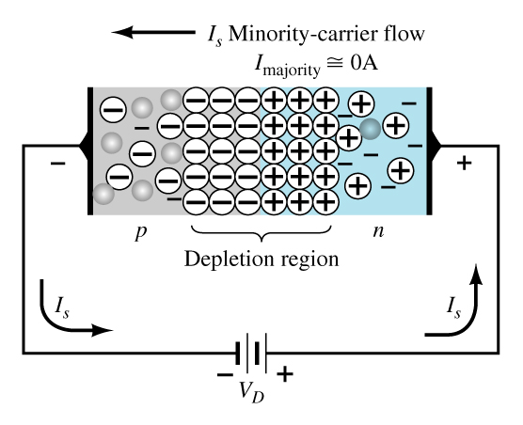
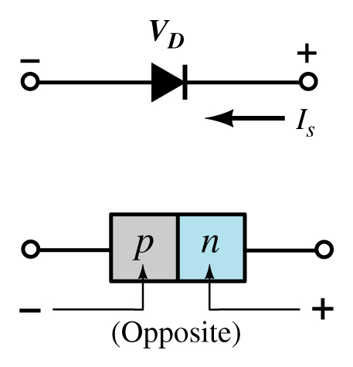
Diode – Reverse Bias
External voltage is applied across the p-n junction in the opposite polarity of the p- and n-type materials.
The reverse voltage causes the depletion region to widen.
The electrons in the n-type material are attracted toward the positive terminal of the voltage source.
The holes in the p-type material are attracted toward the negative terminal of the voltage source.

Slide 14
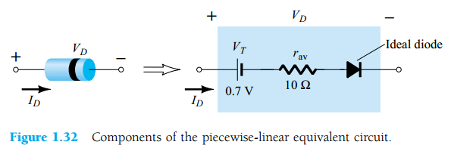
Diode Equivalent Circuit

Slide 15
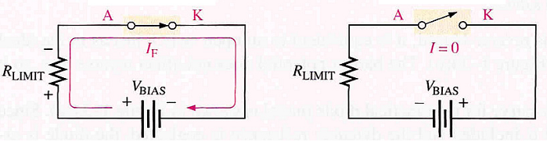
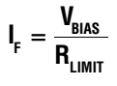
Ideal Diode Model
Works as a switch
Forward bias (switch is close)
Reverse bias (switch is open)
Threshold battery voltage and internal resistance are ignored.
Forward bias
Reverse bias

Slide 16
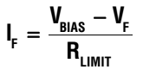
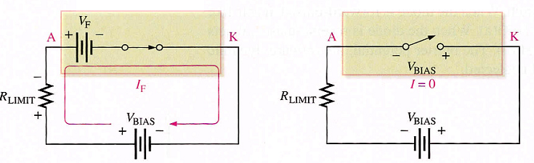
Practical Diode Model
Forward bias
Reverse bias
Constants
Silicon Diode: V_{F} = 0.7V (V_{F} = V_{BIAS} if V_{BIAS} < 0.7V)
Germanium Diode: V_{F} = 0.3V (V_{F} = V_{BIAS} if V_{BIAS} < 0.3V)

Slide 17
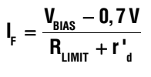
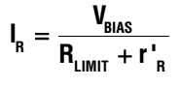
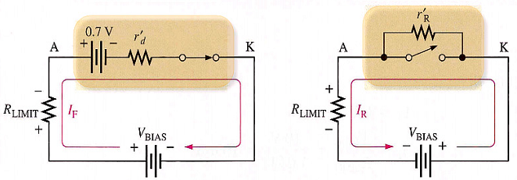
Complete Diode Model
Forward bias
Reverse bias

Slide 18
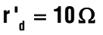
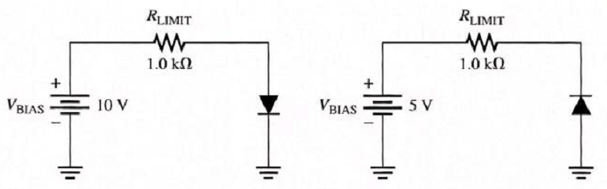
Exercise 3
Given circuit
Forward bias voltage V_{F} = 0.7V
Internal resistance
Determine V_{F}, I_{F} and V_{RLIMIT} for three diode models
Ideal diode model
Practical diode model
Complete diode model

Slide 19
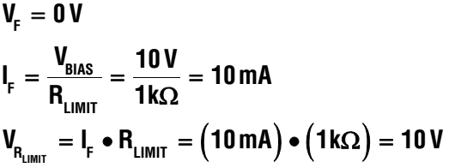
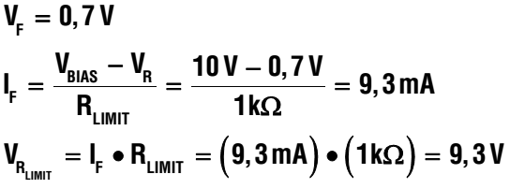
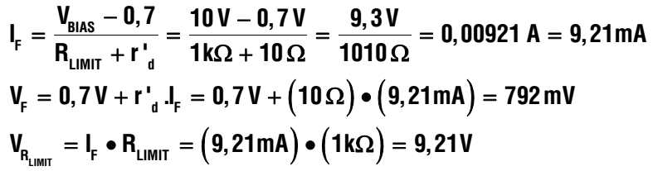
Solution 3
Ideal diode model
Practical diode model
Complete diode model

Slide 20
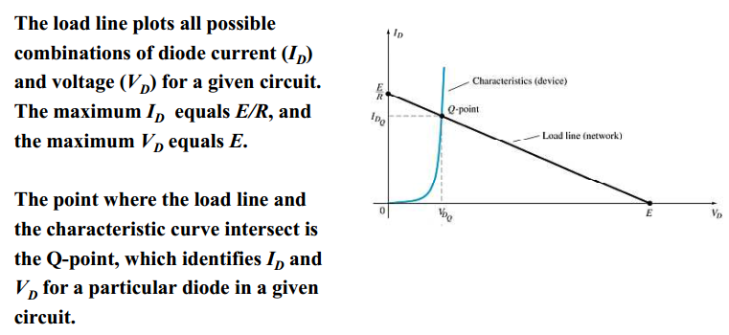
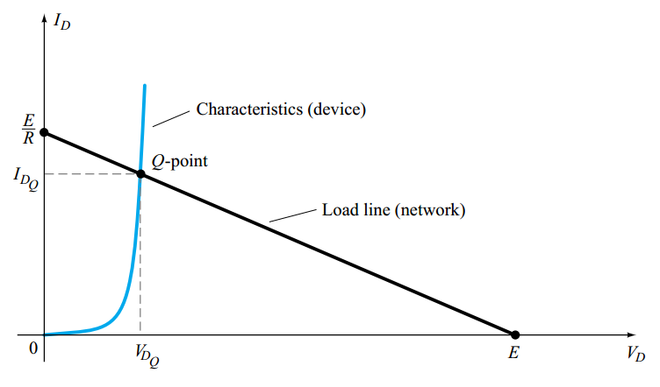
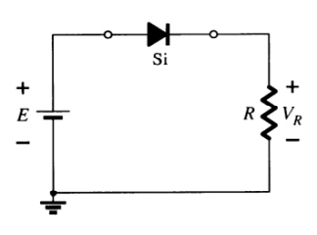
Load-Line Analysis

Slide 21
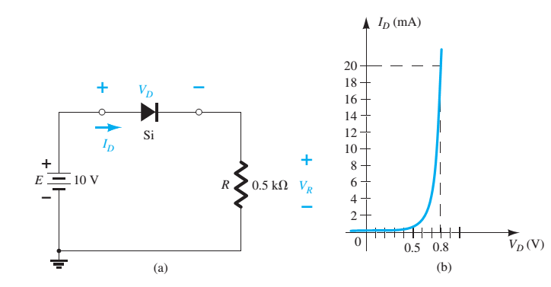
Exercise
Determine V_{D}, I_{D} and V_{R} based on the characteristic of the diode given in the following figure.

Slide 22
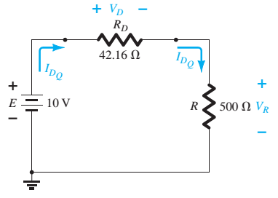
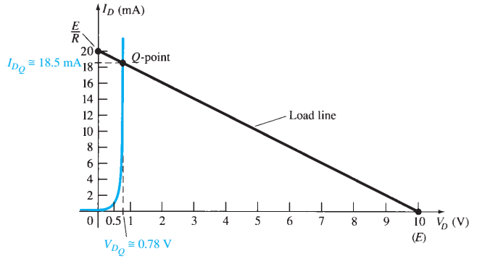
Solution

Slide 23
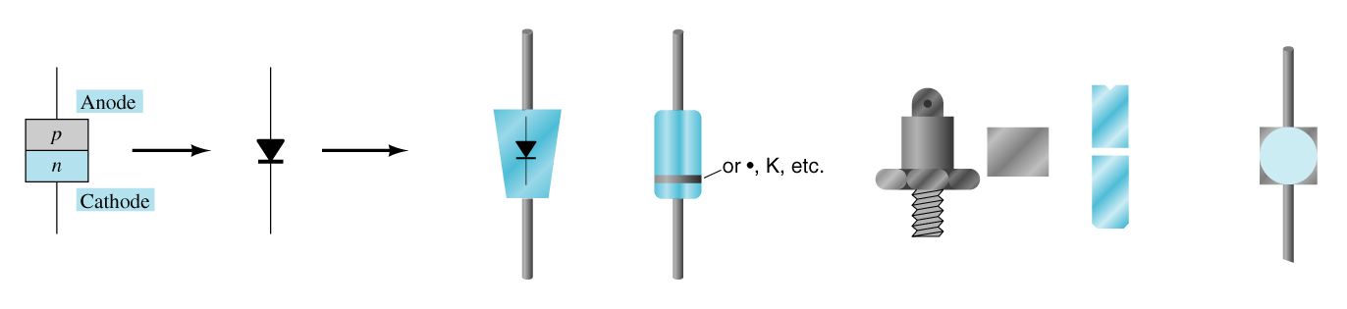
Diode Symbol and Packaging
The anode is abbreviated A
The cathode is abbreviated K

Slide 24
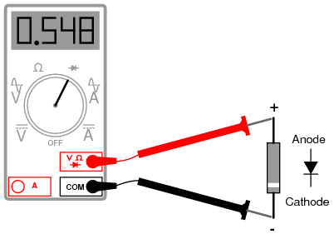
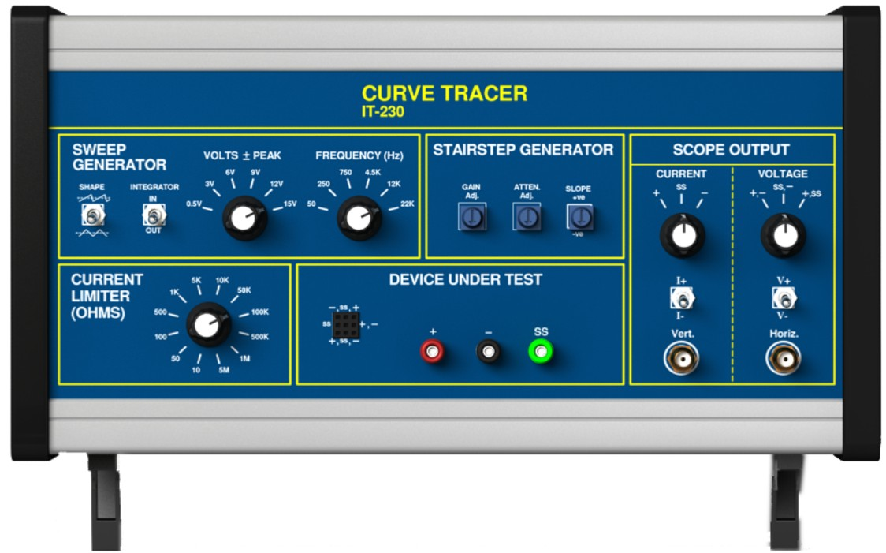
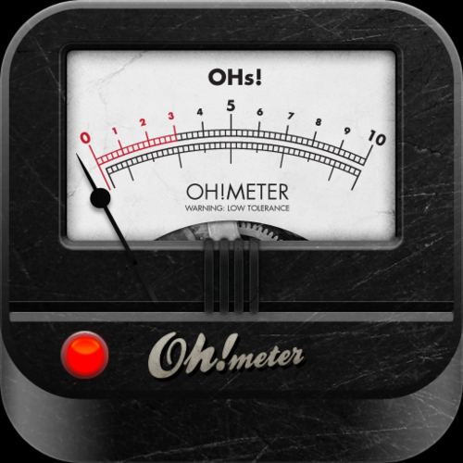
Diode Testing
Diodes are commonly tested using one of these types of equipment:
Diode checker
Ohmmeter
Curve tracer

Slide 25
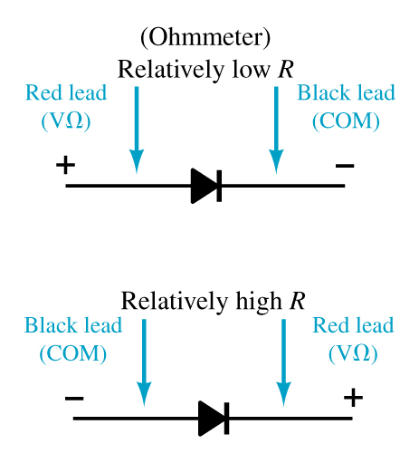
Ohmmeter
An ohmmeter set on a low Ohms scale can be used to test a diode. The diode should be tested out of circuit.

Slide 26
Diode Checker
Many digital multimeters have a diode checking function. The diode should be tested out of circuit.
A normal diode exhibits its forward voltage:
Gallium arsenide ≈ 1.2 V
Silicon diode ≈ 0.7 V
Germanium diode ≈ 0.3 V

Slide 27
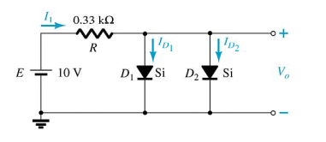
Exercise 2
Determine
I₁, I_{D1}, I_{D2}

Slide 28
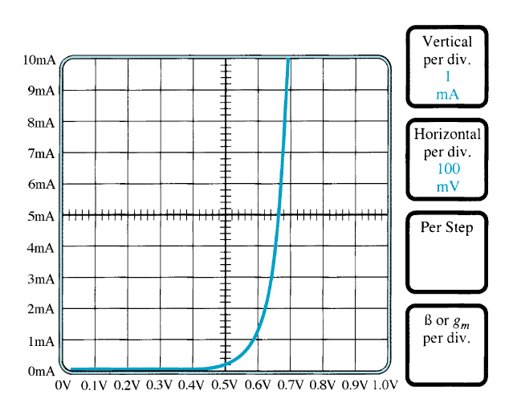
Curve Tracer
A curve tracer displays the characteristic curve of a diode in the test circuit. This curve can be compared to the specifications of the diode from a data sheet.

Slide 29
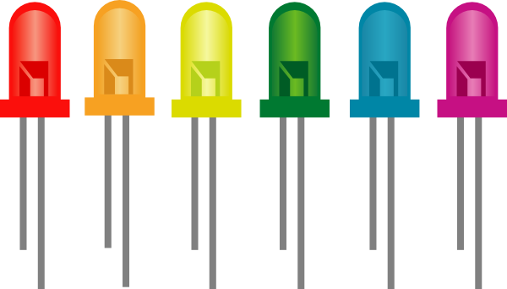
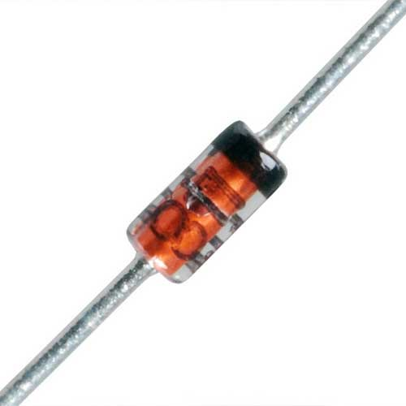
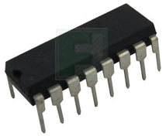
Other Types of Diodes
There are several types of diodes besides the standard p-n junction diode. Three of the more common are:
Zener diodes
Light-emitting diodes
Diode arrays

Slide 30
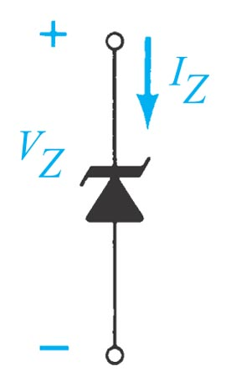
Zener Diode
A Zener diode is one that is designed to safely operate in its zener region; i.e., biased at the Zener voltage (VZ).
Common zener diode voltage ratings are between 1.8 V and 200 V

Slide 31
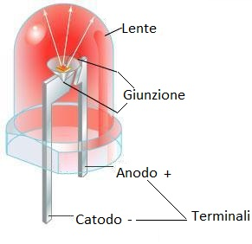
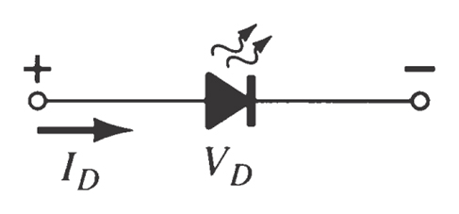
Light-Emitting Diode (LED)
An LED emits light when it is forward biased, which can be in the infrared or visible spectrum.
The forward bias voltage is usually in the range of 2 V to 3 V.

Slide 32
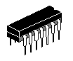
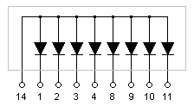
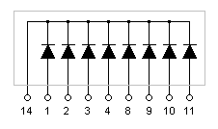
Diode Arrays
Multiple diodes can be packaged together in an integrated circuit (IC).
A variety of diode configurations are available.
Common Anode
Common Cathode

Slide 33


DC Adapter Circuits

Slide 34

Diode Application - Reverse Current Protection
Mandatory design for any system
Drawback: around 0.7V loss because of the forward voltage drop.
→Schottky diodes an excellent choice for reverse protection diodes.

Slide 35

Diode Application – Reverse Current Protection
SIM800L: 4.3V

Slide 36


Diode and Its Application
Half-wave Rectification
Full-ware Rectification

Slide 37



Half-Wave Rectification
AC: Alternating Current DC: Direct Current
Convert AC to DC using one Diode
Rectifier

Slide 38



Half-Wave Rectification (cont.)

Slide 39



Full-Wave Rectification
Convert AC to DC using two or four diodes
Full-Wave
Rectifier

Slide 40

Bridge Rectifier

Slide 41

Ripple in Rectification

Slide 42



Diode Application - AC to DC Converter

Slide 43

Complete AC/DC Power Circuit

Slide 44


Logic Gates
OR
AND

Slide 45

Exercise 4
Given circuit
Reverse current
Determine V_{F}, I_{F} and V_{R} for three diode model
Ideal diode model
Practical diode model
Complete diode model

Slide 46

Exercise 5
Analyze and validate the value of the voltmeter in case of using ideal diode model ?
Notes:
a. Diode is broken or the connection is fail

Slide 47


Slide 48


Pull Up and Pull Down Registor
Pull-up and Pull-down resistors are used to correctly bias the inputs of digital gates to prevent them from floating about randomly when there is no input condition

Slide 49

Pull-up Resistors
Short circuit
Good connection

Slide 50



Calculating Pull-Up Resistor Value
TTL 74LSxxx series:
Input high: V_{IH(min)} = 2.0V, I_{IH(max)}= 20µA
Input low: V_{IL(max)} = 0.8V, I_{IL(max)}= 0.4mA
Single Gate Pull-up Resistor Value
Multiple Gate Pull-up Resistor Value (10 inputs)

Slide 51

Calculating Pull-Up Resistor Value
A Pull-down resistor works in the same way as the previous pull-up resistor, except this time the logic gates input is tied to ground, logic level “0” (LOW)

Slide 52
Example
TTL 74LS00 NAND Gates along with a single-pole double-throw switch are to be used to make a simple set-reset bistable circuit signal. Calculate: 1). The maximum pull-up resistor values if the voltage representing a logic HIGH input is to be held at 4.5 volts when the switch is open, and 2). The current flowing through the resistor when the switch is closed (assume zero contact resistance). Also draw the circuit.
Data given: Vcc = 5V, V_{IH} = 4.5V, and I_{IH(max)} = 20μA

Slide 53



Answer
Set-Reset Bistable Circuit

